Slide 1
Office 365 Development

Slide 2
Office 365 Development Overview

Slide 3

Agenda
Intro
Office 365 App Model
Office 365 APIs
Tools
Resources

Slide 4
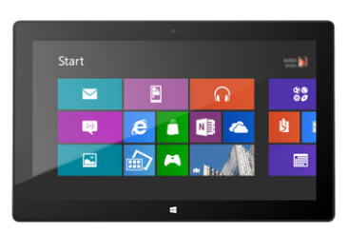
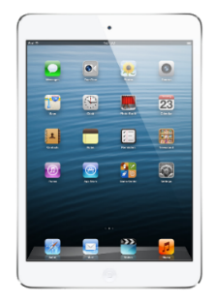


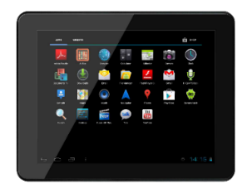
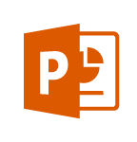
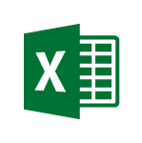
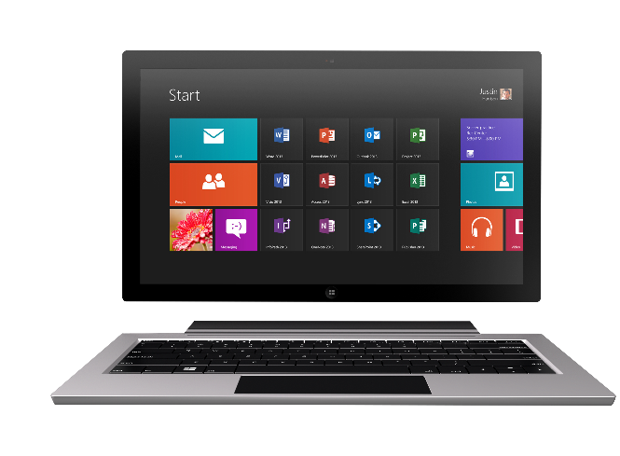
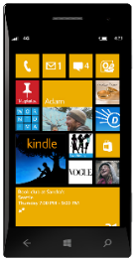
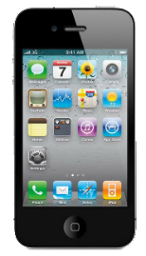
Technology journey
PC
1990s
PC + Servers
2000s
Devices + Cloud
2010s
VBA
VBA
Com add-ins
VSTO
FTC
Open standards
Mobile SDK’s
Notes:
Technology Journey
Respect for the investments that you’ve already made
Reaching out to a whole new world of possible.

Slide 5
The Opportunity
Mobile Devices
1.2B in 2014
1.8B in 2018
1B+
400+ PB
2-3 hours/day in Office Apps
Notes:
400+ Petabytes of data

Slide 6
Office 365 is a rich platform ripe for extending and integrating with.

Slide 7
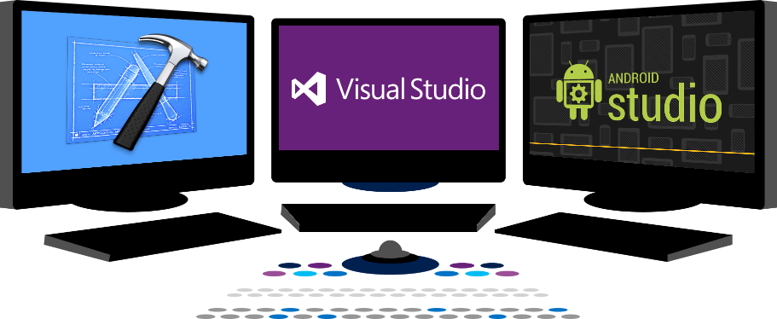














Vision
EXTEND OFFICE EVERYWHERE
CONNECT TO OFFICE 365 SERVICES
BUILD USING AN OPEN PLATFORM
Delve
z
Users and groups
Files
Mail
Calendar
My Apps
Video Portal
Contacts
Office Graph
Presentations
Documents
Spreadsheets
Lync
OneNote
Yammer

Slide 8
Office 365 App Model
Office 365 Development Overview

Slide 9


Contextual Apps
Your Apps, our UI
Surface your apps in the Office 365 platform
In Context
In context of your business users productivity activities
Reach
In Office Client, Office Online and Modern Apps
Notes:
The Cloud App Model provides a loosely coupled architecture for building apps in SharePoint 2013. This loosely coupled architecture gives the freedom of choice for developers in the technologies they use to not only host their applications but also the tools they use to write them. These apps leverage industry web standards such as HTML, JavaScript, jQuery, JSON, REST, OData and OAuth to provide apps an integrated user experience, yet architecturally provides for loose coupling with SharePoint 2013.
Apps for SharePoint execute “off-server” which allows for the app to scale independently of SharePoint and provides for a more secure SharePoint environment. You have complete control how apps interact with SharePoint. IT has complete control on how users discover, acquire and license apps. IT can specify which apps are white listed for install, or provide a mechanism where users can request an app that requires IT approval to install.
Apps can be accessible from any device with a web browser whether it be a PC, Tablet or smart phone. If it has a web browser that supports the latest web standards then it can be used.
Supporting Technologies
Client Side Rendering
Cloud App Model
REST End-Points
Client Object Model
OAuth 2.0
Visual Studio
NAPA

Slide 10

Web Standards
Apps are built using industry proven web standards such as HTML, JavaScript and REST
Scalable and Safe
Apps are independently scalable which reduces total cost of ownership. Apps are secured and isolated from SharePoint
Accessible
Apps can be accessed from any device with a web browser.
Build apps
Notes:
The Cloud App Model provides a loosely coupled architecture for building apps in SharePoint 2013. This loosely coupled architecture gives the freedom of choice for developers in the technologies they use to not only host their applications but also the tools they use to write them. These apps leverage industry web standards such as HTML, JavaScript, jQuery, JSON, REST, OData and OAuth to provide apps an integrated user experience, yet architecturally provides for loose coupling with SharePoint 2013.
Apps for SharePoint execute “off-server” which allows for the app to scale independently of SharePoint and provides for a more secure SharePoint environment. You have complete control how apps interact with SharePoint. IT has complete control on how users discover, acquire and license apps. IT can specify which apps are white listed for install, or provide a mechanism where users can request an app that requires IT approval to install.
Apps can be accessible from any device with a web browser whether it be a PC, Tablet or smart phone. If it has a web browser that supports the latest web standards then it can be used.
Supporting Technologies
Client Side Rendering
Cloud App Model
REST End-Points
Client Object Model
OAuth 2.0
Visual Studio
NAPA

Slide 11

Write once, run anywhere
An app can run outside the firewall in the cloud and from inside the firewall in a data center.
Hosting freedom
Apps can be hosted on any platform giving you complete freedom.
Re-use logic and assets
Build apps that can share logic and code with other web hosted solutions. Re-use existing services and assets within you app.
Build for the cloud
Notes:
By nature the Cloud App Model allows for the implementation of the app to be independent of the SharePoint platform. This gives you freedom of choose in how you develop and host your apps. This means you could develop them using Microsoft tools or non-Microsoft tools such as Eclipse. You can host the on Windows Azure or host them in Linux, Amazon Web Services, etc… The choices are endless and completely up to you.
The apps you right can re-use logic and code you already have for other web based apps or services. Or you can use logic and code for an app in other web apps or services. That’s the power and freedom of the cloud.
Supporting Technologies
Cloud App Model
Platform Agnostic

Slide 12









Modern app development
Apps
Products and platforms
Services and data
Expense
calculator
Vacation
request
Event
planning
Help-desk
support
Learning management
Risk
management
App catalog and store
Notes:
It’s worth spending some time taking you through how we think about modern app development at Microsoft. We have a series of products and platforms like SharePoint and Office that provide a lot of great out-of-the box functionality to help us be productive. To get even more from these products we want to be able to bring information in from other places. Services and data sources like Dynamics, Bing or something that lives out on the web or in the cloud.
With the latest version of SharePoint we’re making it easier to bring together rich web services and data to create powerful new apps. Apps run outside of the SharePoint process, are hosted externally and can be exposed through REST API’s.
Today there are more than 700,000 SharePoint application developers and with this release we’re providing them with a place to surface their apps through an online marketplace of rich partner solutions and applications designed to work with SharePoint and Office.

Slide 13

App Model Development
If you know general web development, you also know Office 365 development…
Notes:
Same code works in cloud and in on-premises
Build market place apps and reach all Office 365 customers easily
More flexible model with additional possibilities
Standard .NET development tooling

Slide 14
demo
Apps for SharePoint
Notes:
AvePoint Meetings
Nintex

Slide 15
demo
Apps for OFFICe
Notes:
WIkiPedia
DocuSign

Slide 16


Distribution choices
Office Store
App Catalog
Notes:
Lifecycle
Not just the store
Momuntem has been building store and on-prem
Store features ; subscriptions
Business-ready
Corporate catalog
Training users to get new experiences

Slide 17




Store momentum
Exponential growth In-store visits
International expansion
Hundreds of business apps
Available in 142 markets
Notes:
Slow start, but building.
Not a device marketplace. No millions and millions of apps.
Tons of enhancement in the last year: subscriptions, regional, etc.
Lot of investment and expansion into new markets. Seeing good growth in new markets.
8 Additional Store Fronts Opening July
Local L:anguage Apps For :
China / Netherlands / Russia / Italy / Brazil
Recent Addition of subscription priced apps and paid Outlook apps
Store Refresh coming …

Slide 18
Office 365 APIs
Office 365 Development Overview

Slide 19
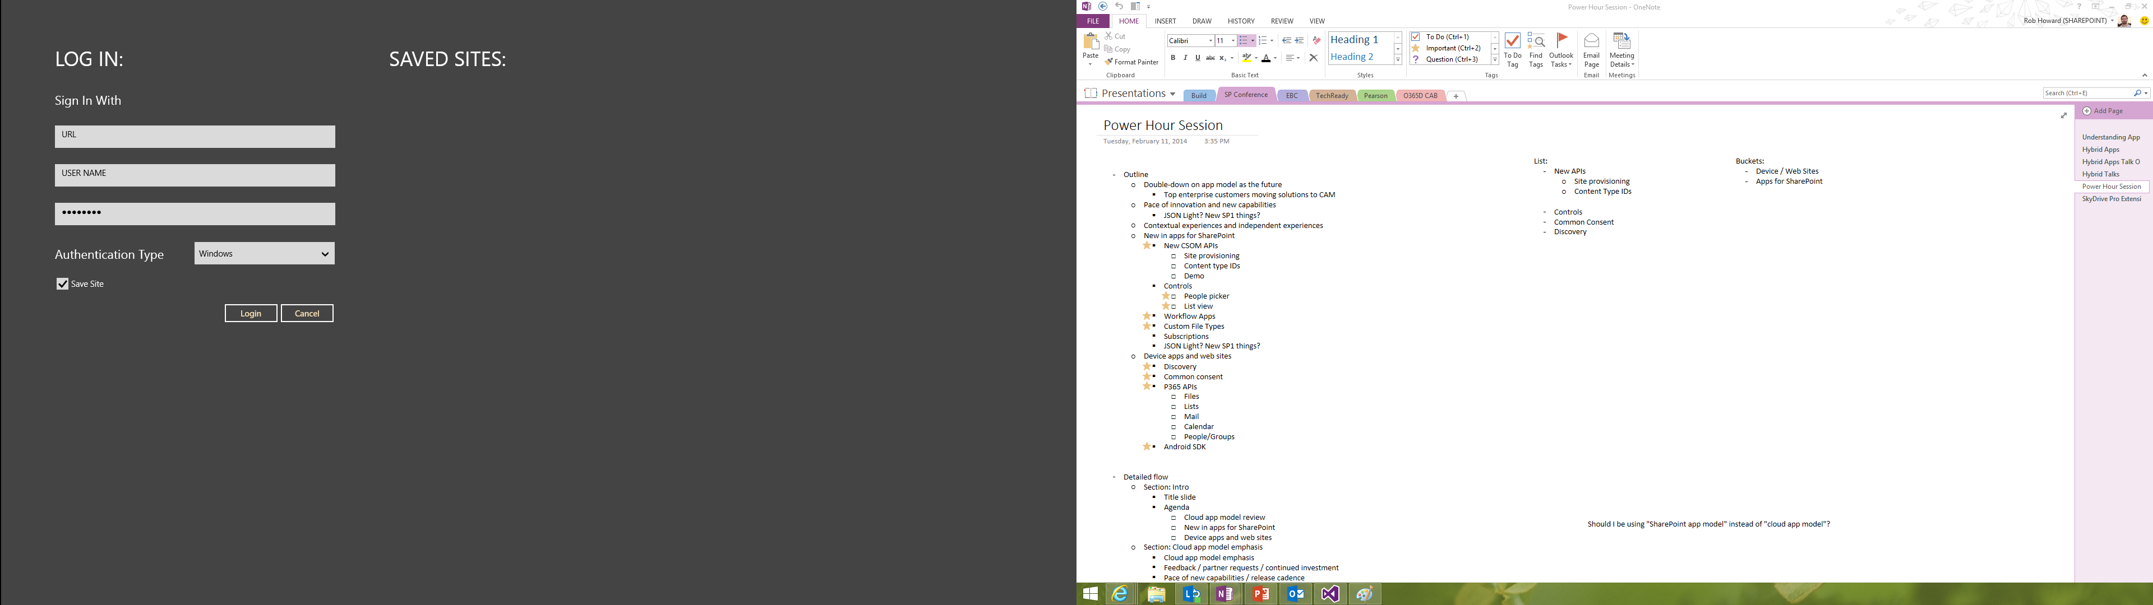
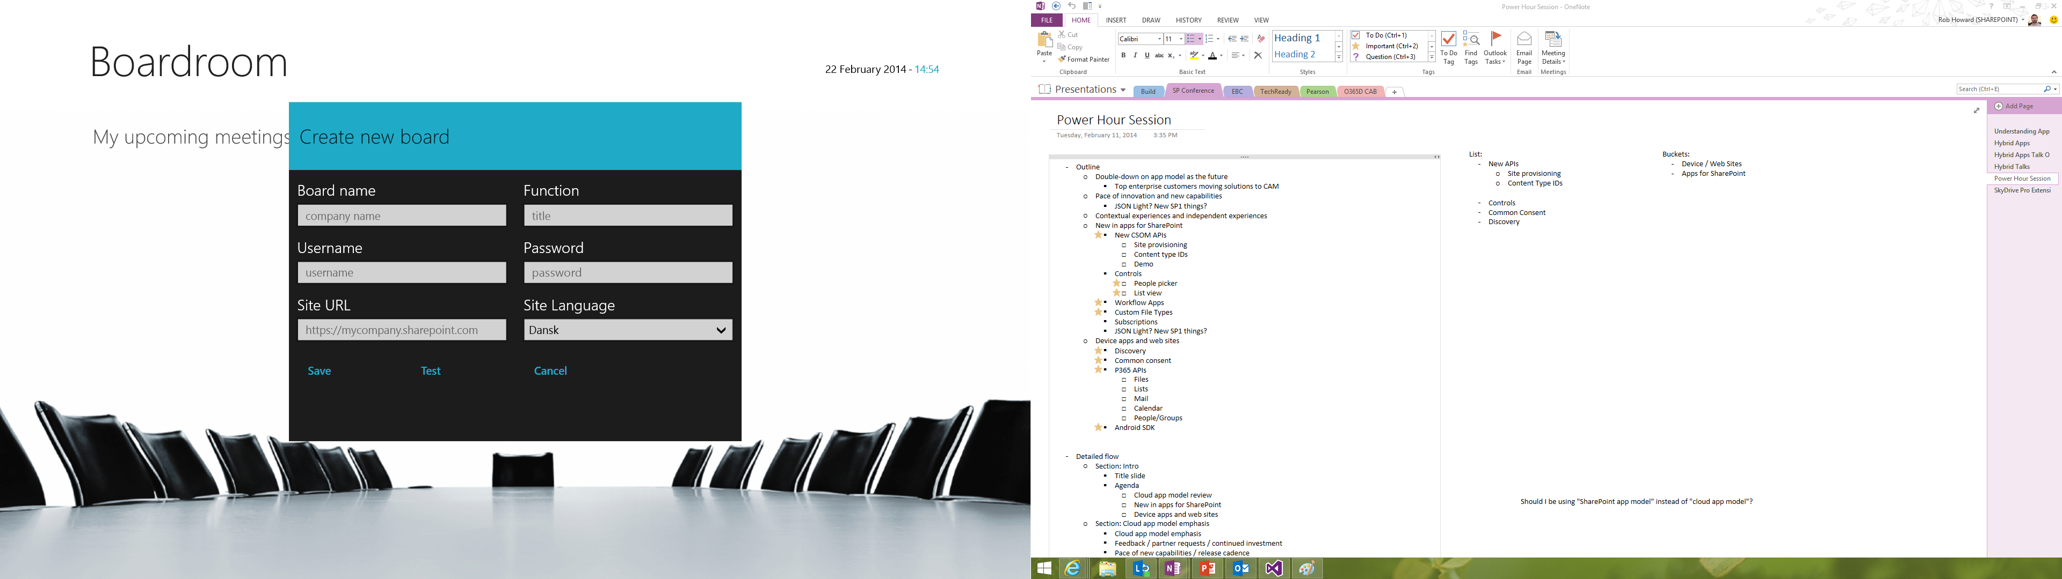
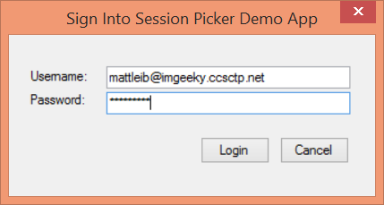
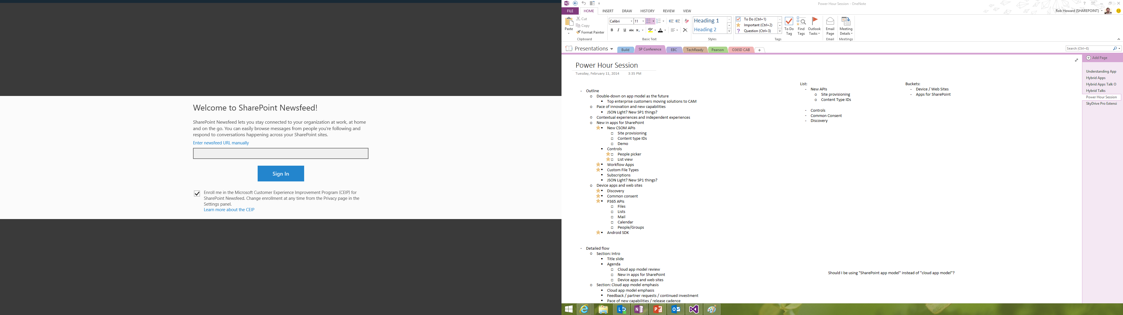
Office 365 device apps

Slide 20
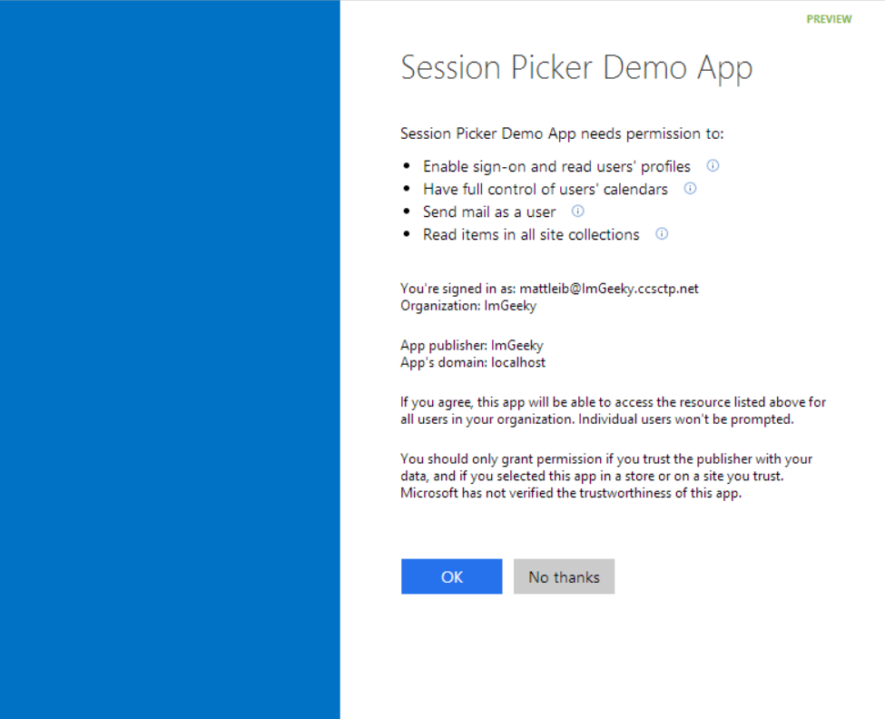
Common Consent

Slide 21
The SharePoint client APIs
Sites, Lists and Libs
Workflow
Search
Taxonomy
BCS
…
_api
Execute query
REST/ OData
JavaScript library
Silverlight library
.Net CLR library
Custom client code

Slide 22
Office 365 APIs
Active Directory
Exchange & Outlook.com
SharePoint
OneDrive
Sites
OneDrive
Users
Mail
Calendar
Client API
OneDrive for Business
Sites, Lists and Libs
Taxonomy
Groups
Contacts
Workflow
BCS
Search
…

Slide 23
demo
Asp.net MVC project
Notes:
Research Project

Slide 24
demo
Windows 8.1
Notes:
EmpOnBoard by Chaks

Slide 25
demo
CORDOVA project

Slide 26
Continuous innovation
LAST YEAR
THIS YEAR
THE FUTURE
Apps for SharePoint
Apps for Office
VS tooling
Store and lifecycle
Contextual apps
Compose time apps
Robust Office 365 APIs
Tools and platform
Android SDK
Adding new endpoints
More APIs (Tasks, Office Graph)
iOS SDK
Embracing Open
Integrating platform + Tools
Empowering users
Notes:
Specific talking points on “show some leg:”
Endpoints
Building Apps for Office on the MAC
Filling in Apps in Office Online, Word
Connecting Entities
Adding Entities for feeds and tasks.
Embracing more of O365
Working on tools to help developers navigate between entities, like you see in Pulse (We’re showing this, right?)
Embracing Open
Double-down on open standards, interop, protocols and programming frameworks
Making more open source projects
Contributing to more open source projects
Integrating Platform
Easier to manage apps across Azure and O365
More support from VS for apps across not just SharePoint, but all of O365
Empowering Users
Make it easier for users to build solutions without code
Connect those solutions to enhancement from pro-devs

Slide 27
Tools
Office 365 Development Overview

Slide 28
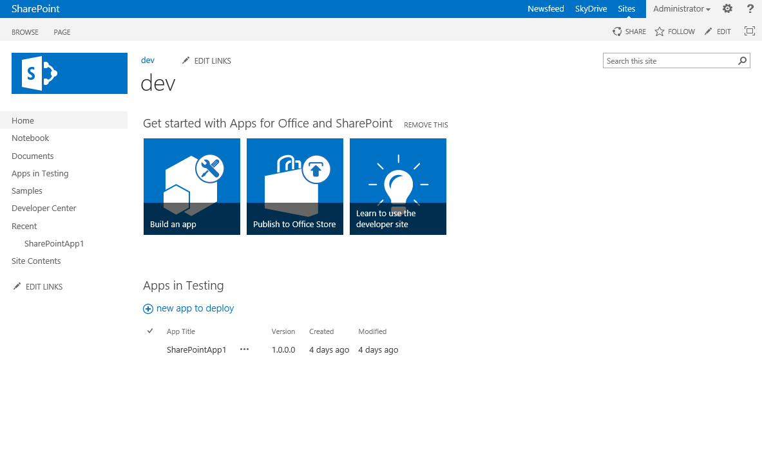
Developer template and usage
Enables remote development against the SharePoint farm
Also with on-premises deployments

Slide 29
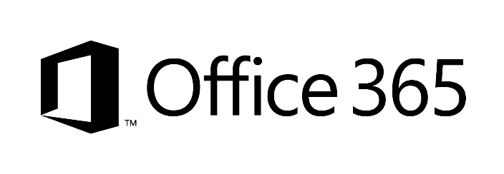


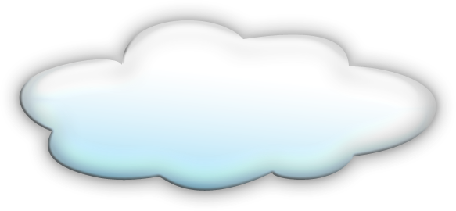


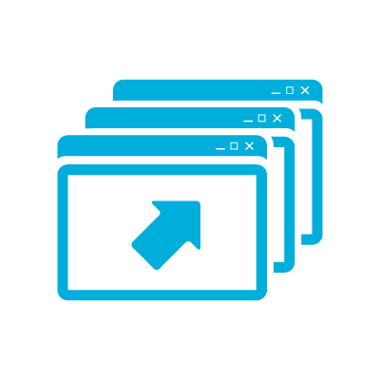



Developer sites and remote development
2
1
3
1
4
1
Notes:
Clients using remote development tools
Preferred option is to use Office365 – you can share even the same instance cross your App developers
You can also host your SharePoint Windows Azure IaaS server – so that development occures agains that instance
Just as for IaaS, you can do development againts shared on-premises instance – most likely you’d dedicate site collection per developer for testing usage
TFS – could be on-prem, hosted in IaaS platform or used as service from cloud

Slide 30
Resources
Office 365 Development Overview

Slide 31
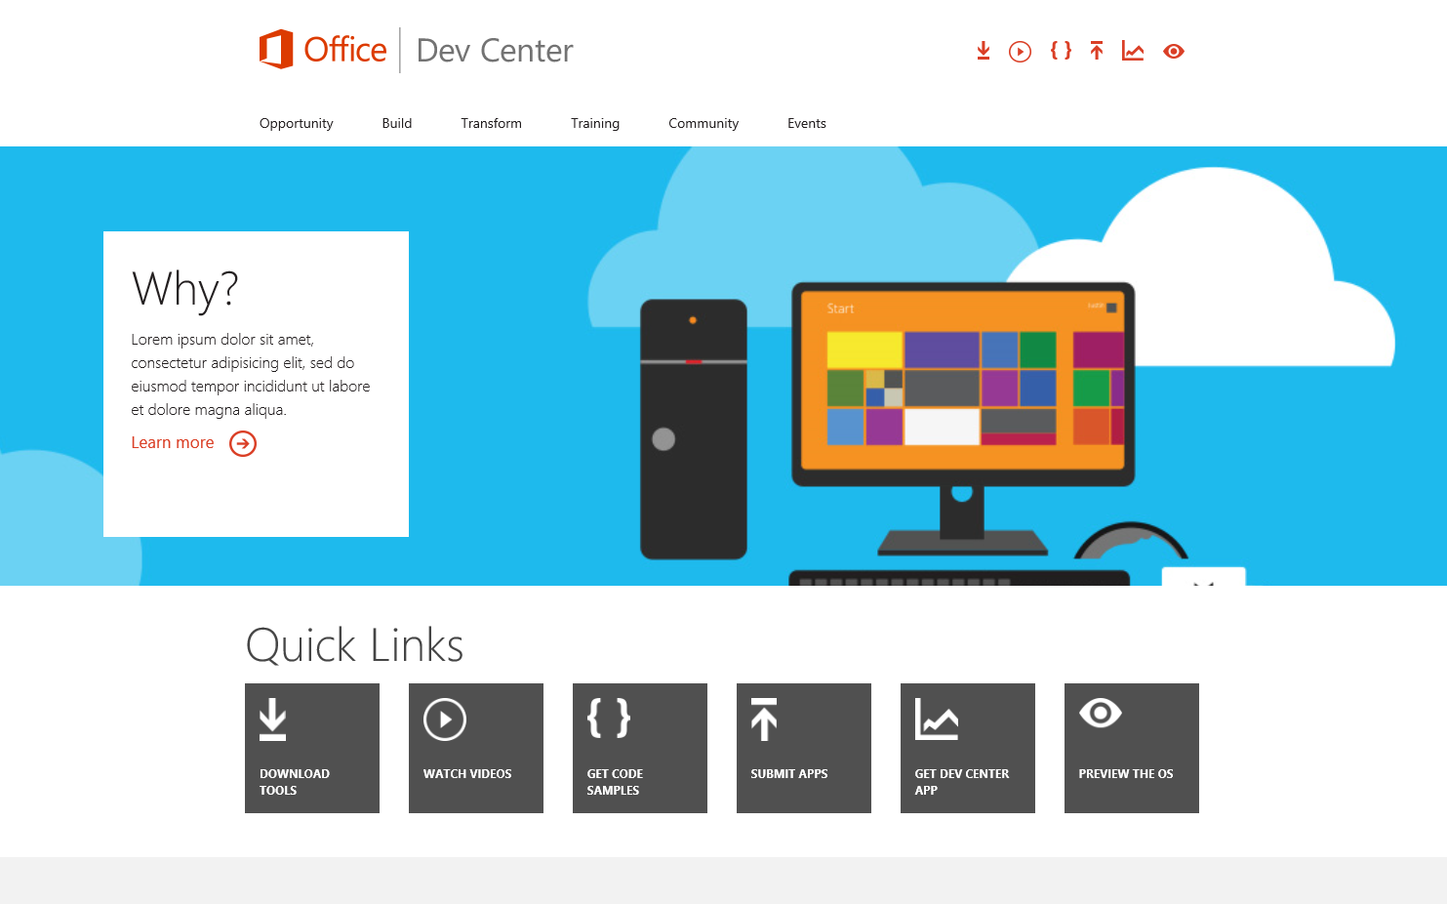
Office 365 Developer Center
dev.Office.com
Opportunity
Build
Transform
Code Samples
Patterns & Practices
API Reference
Community

Slide 32
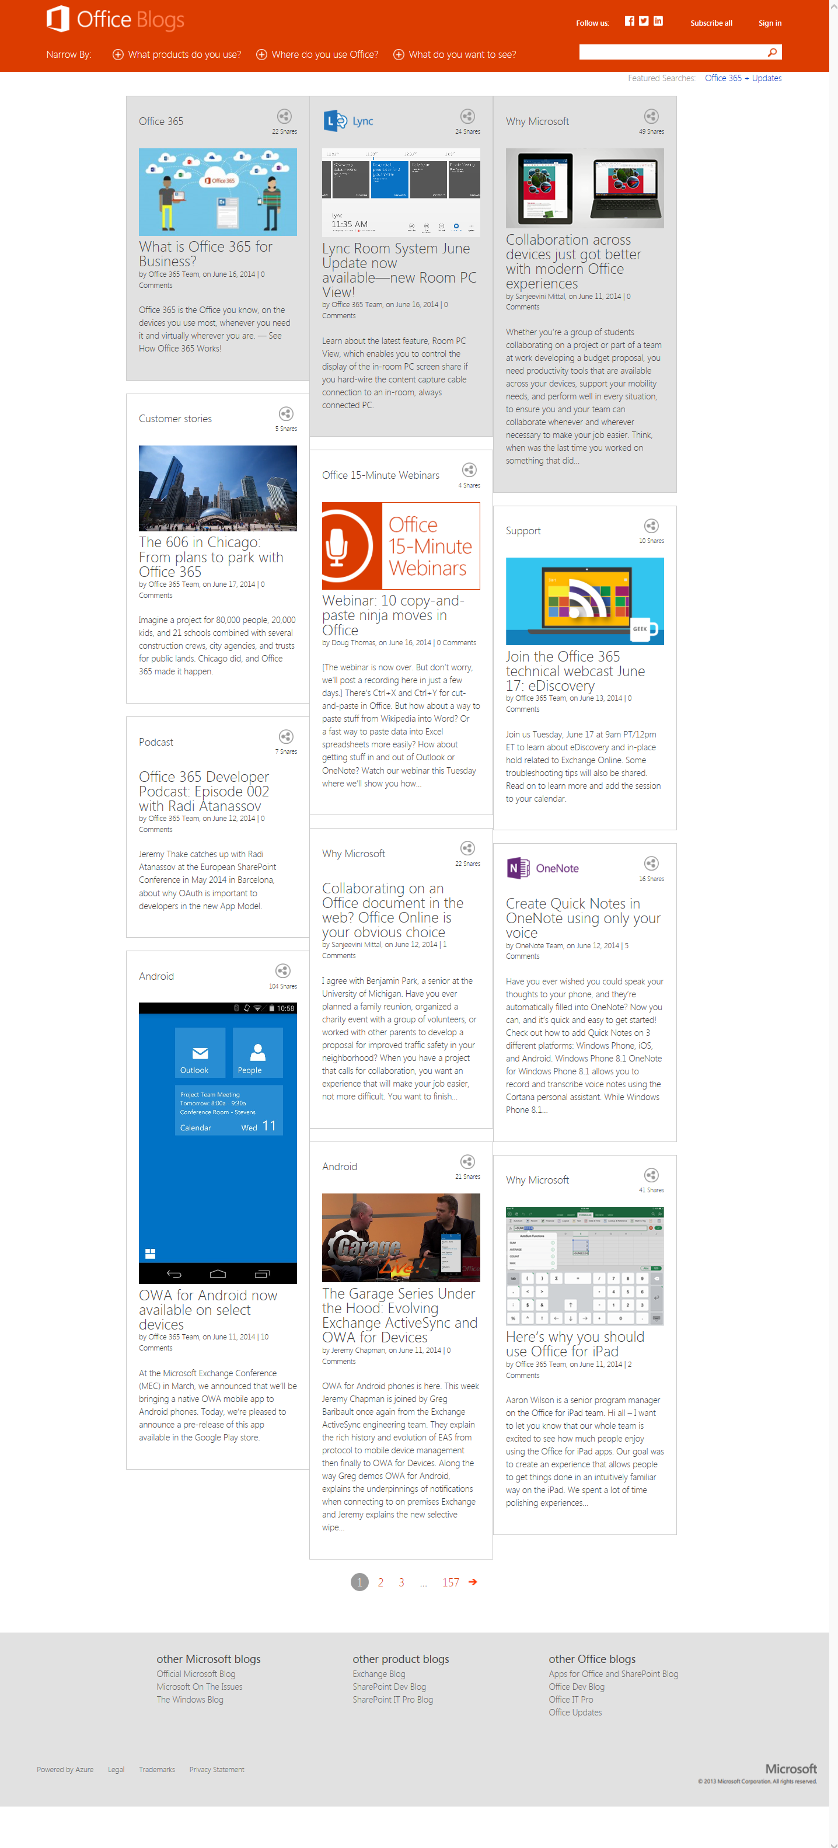
Office Blogs
Office 365 news
Dev announcements
Events
Garage Series videos
Weekly podcast

Slide 33
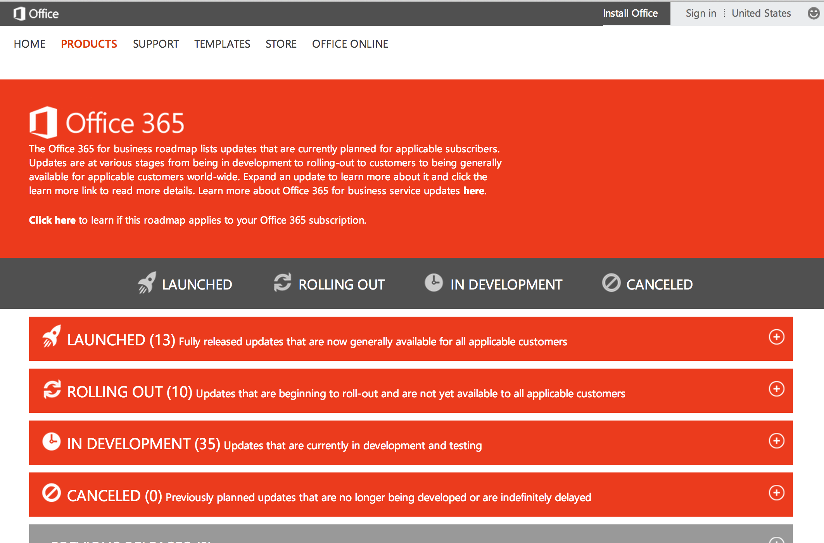
Roadmap
Monthly updates
Developer features
Associated blog posts

Slide 34
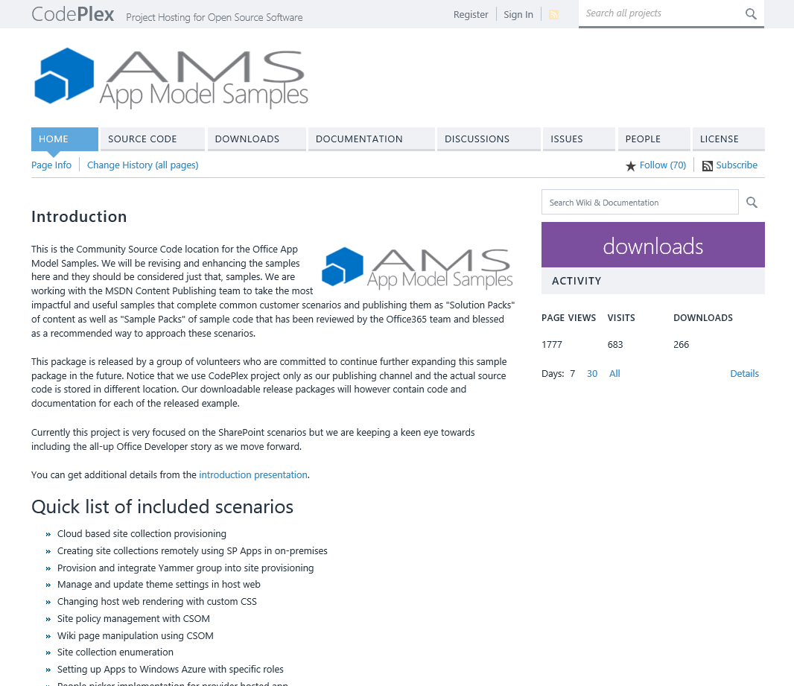
Patterns & Practices
Providing App Model Patterns for common Full Trust Code scenarios
30+ Visual Studio Projects
Common scenarios
Branding
Site Provisioning
Remote Event Receivers
Large file support
Taxonomy driven navigation
And much more…
Contribute
Open source coming soon!

Slide 35
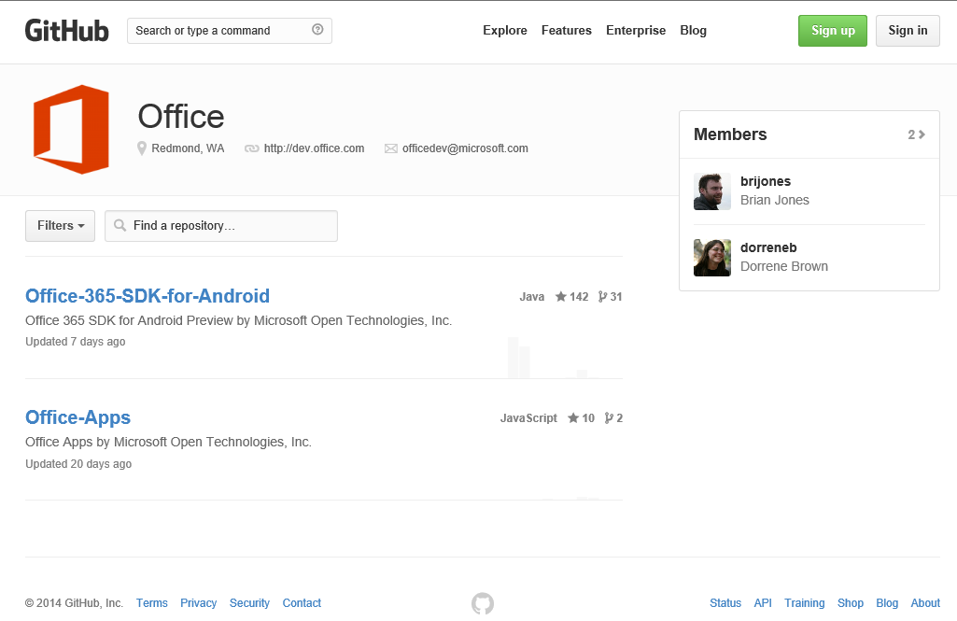
GitHub
Github.com/OfficeDev
SDKs
Android SDK
Code Samples
WikiPedia App for Word
Campaign Manager for Android
Expense Manager for Windows 8
Research Manager inc. AngularJS
Building Snippets for Word
Contribute
We want your enhancements and your samples!

Slide 36
Courses
Office 365 Development
Course 1: Introduction to Office 365 Development
Course 2: Deep dive into the Office 365 App Model
Course 3: Deep Dive into integrating Office 365 APIs with your standalone web application development
Course 4: Deep Dive into integrating Office 365 APIs with your mobile device development
Course 5: Shipping your Office 365 App to the Office Store
Course 6: Deep dive into the building blocks and services of the SharePoint platform
Course 7: Deep Dive into Office 365 Development on non-Microsoft Stack

Slide 37
Summary
Intro
Office 365 App Model
Office 365 APIs
Tools
Resources

Slide 38



dev.office.com
Sign up
http://dev.office.com/getting-started
Explore
http://apisandbox.msdn.microsoft.com
Get trained http://dev.office.com/training

Slide 39


Feedback
Office 365 Network Share you best practices and join conversations https://www.yammer.com/itpronetwork
Stackoverflow Ask deep technical questions to a world-wide set of developers
http://stackoverflow.com/questions/tagged/ms-office
UserVoice Provide suggestions of what you want in future versions
http://officespdev.uservoice.com/

